Slide 1

Anesthesia
By: Marina, lara, pol and iker.s

Slide 2

An early WAY of anesthesia was first used at Massachusetts General Hospital in Boston by dentist William t.g.morton and surgeon john warren on October 16 ,1846

Slide 3

General anesthesia works by interrupting nerve signals in your brain and body. It present your brain from processing pain and from remembering what happened during your surgery.
Esta foto de Autor desconocido se concede bajo licencia de CC BY-SA-NC.

Slide 4
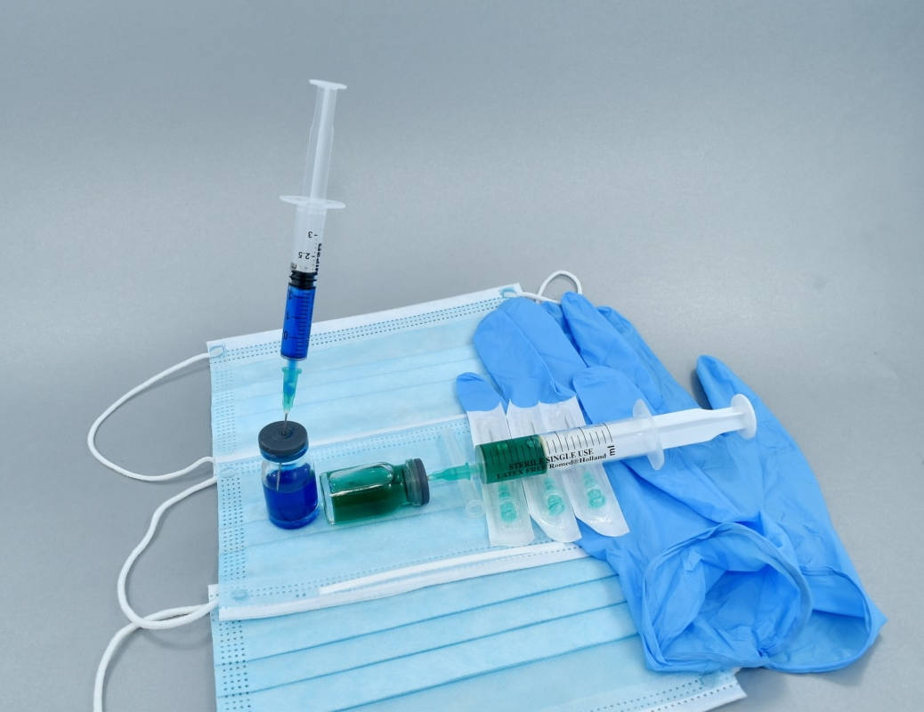
A lot of years ago, the first attempts at general anesthesia were probably herbal remedies are adminestred in prehistory. Alcohol is the oldest know sedative; was use it in Mesopotamia thousands of years ago.

Slide 5
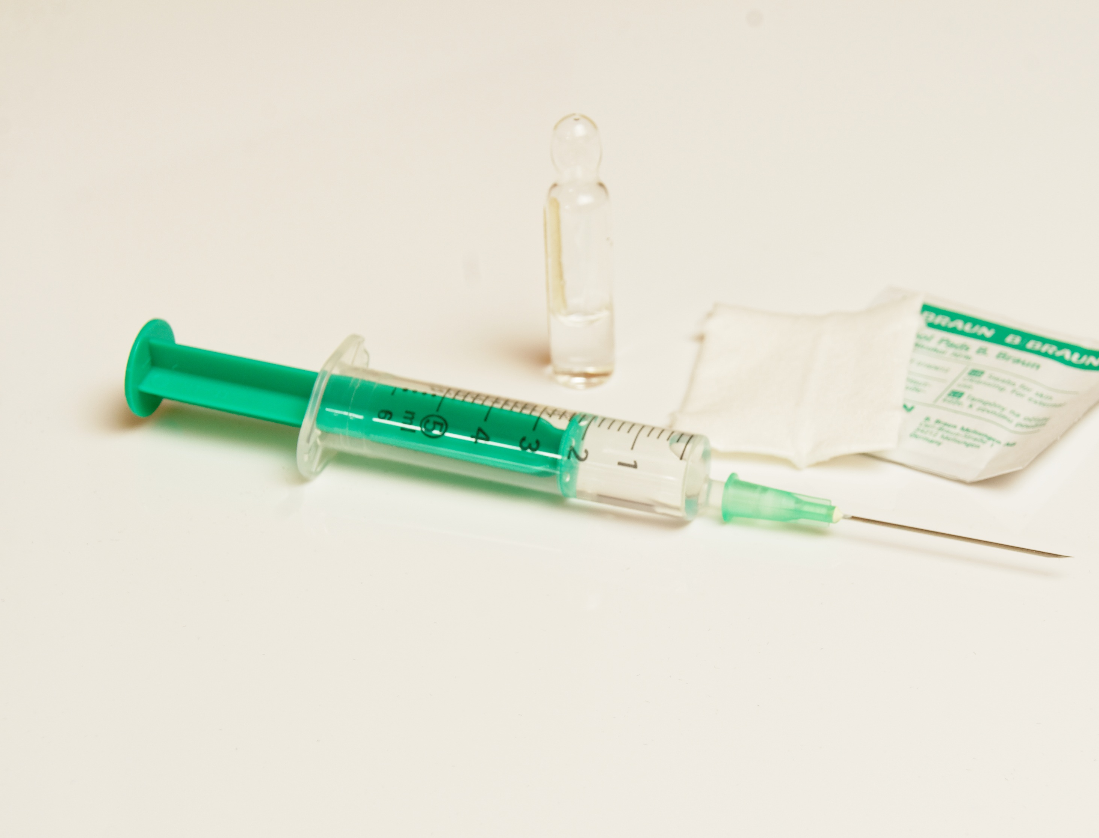
By the end of the century, anesthesia was commonplace, arguably becoming the first example in Wich medical practice was backed by emerging scientific developments.

Slide 6
THANKS FOR LISTENING. HOPE YOU ENJOY IT. BYE!

