Slide 1
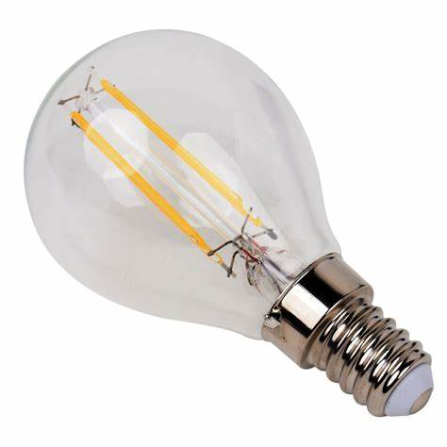
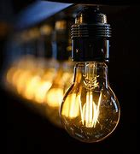
THE BULB
BY: RAUL G, LUCÍA AND CAROL

Slide 2
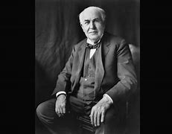
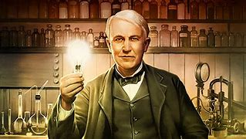
WHEN WAS IT INVENTED? WHO INVENTED THE BULB?
Thomas Edison invented the bulb in 1879.

Slide 3
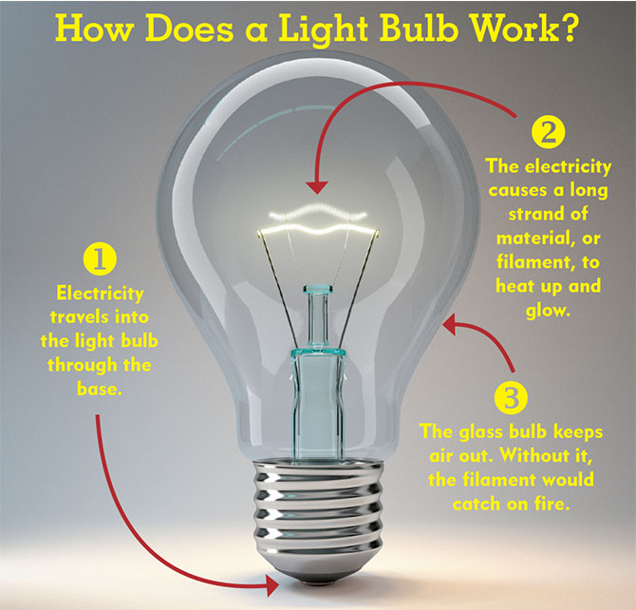
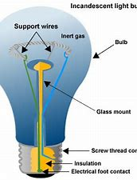
HOW DOES IT WORK?
A light bulb is a simple apparatus that converts electric energy into light energy. The law of conservation of energy says that energy can neither be created nor destroyed, it simply changes form. A light bulb is able to take the electricity supplied to it and change its form into something that can be used for illumination

Slide 4
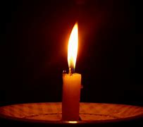
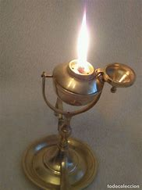

WHAT DID THE PEOPLE DO BEFORE INVENTION?
The only means man had to create light were fire, candles and oil lamps.

Slide 5
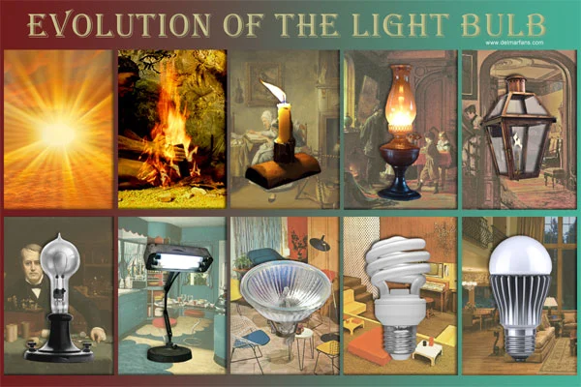
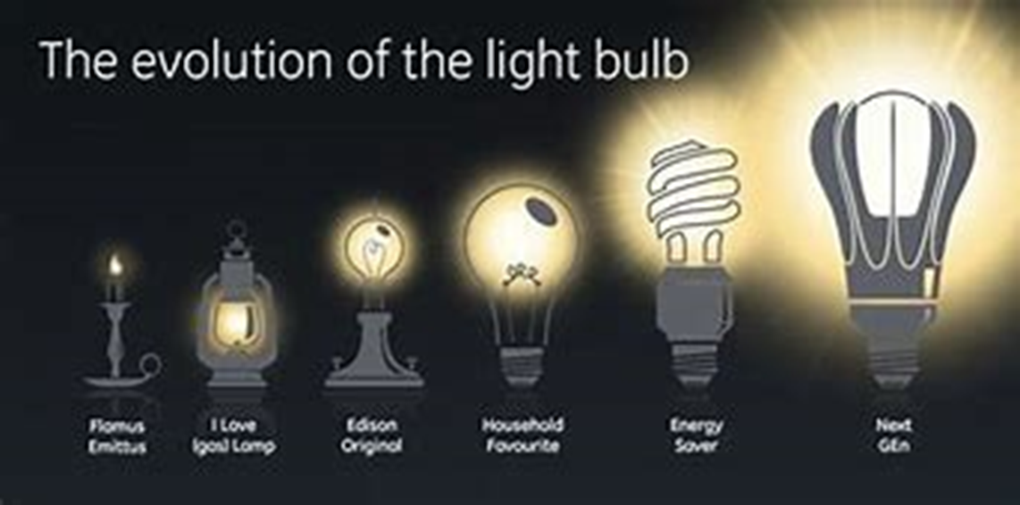
HOW HAS THIS INVENTION CHANGED TROUGH HISTORY
Little by little, the different elements that allowed a lamp to generate light, such as carbon, were replaced by tungsten. It was already in the 60s when the first red Led was created, what is the same, the first LED

Slide 6



THANKS FOR YOUR ATTENTION

