Slide 1
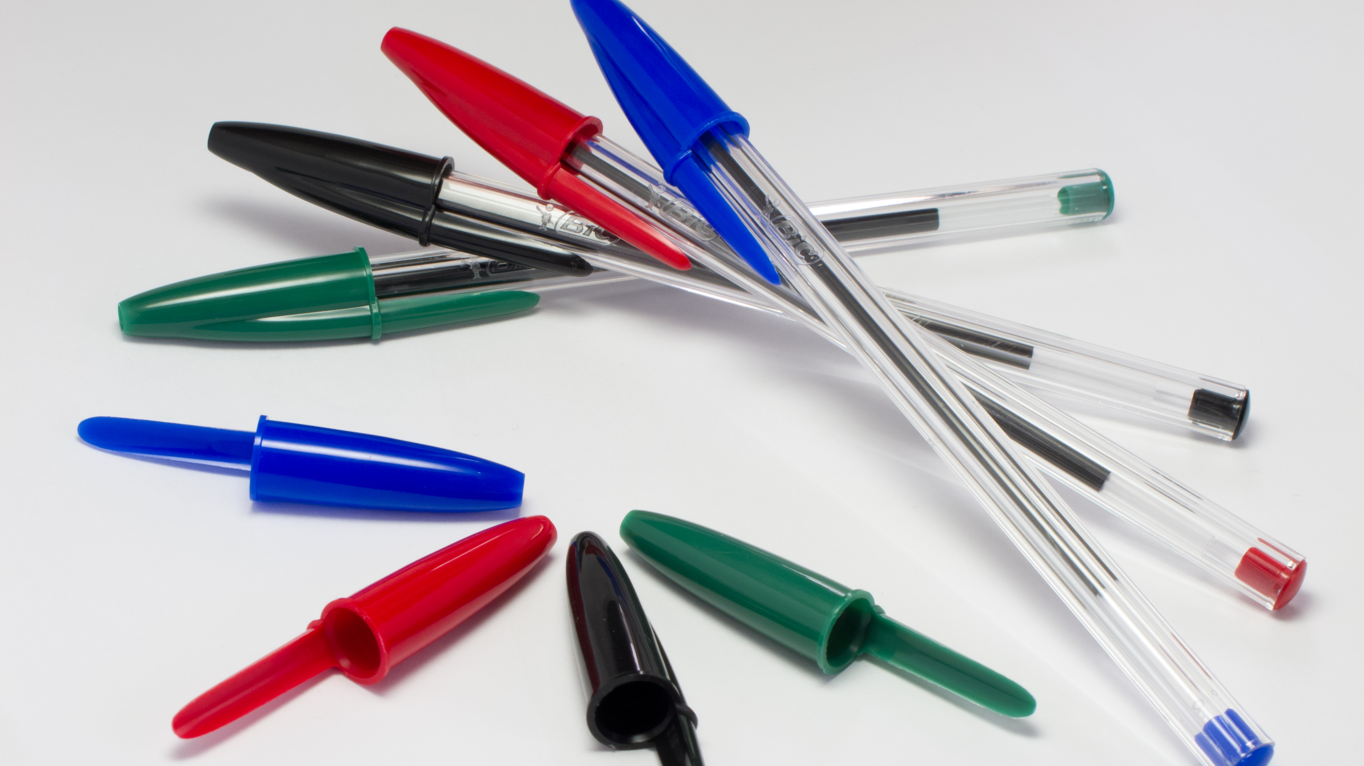
THE PEN
GROUP 6:
Júlia. M
Anna. G
Miguel. C

Slide 2
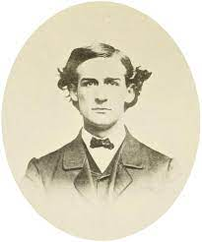
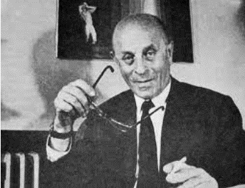
When was it invented? Who invented it?
The pen was discovered in 1888 but it was invented in 1889 by John. J Loud and Ladislao Biro.
The invention was patented on June 10 of 1943 in Argentina because the inventor had to flee because of the threat Nazi
John. J Loud
Ladislao Biro

Slide 3

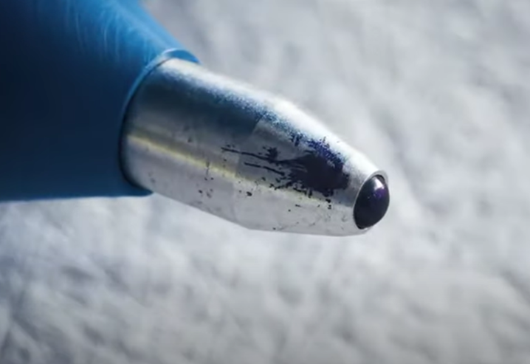
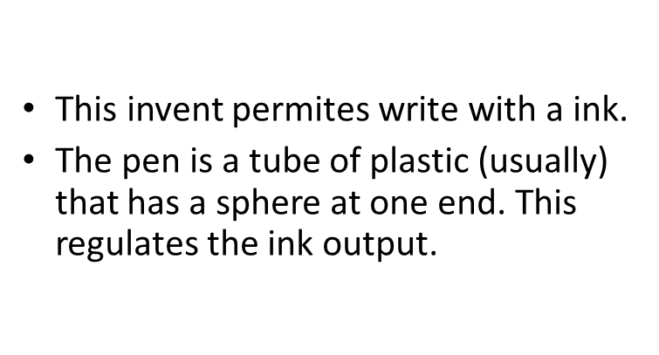
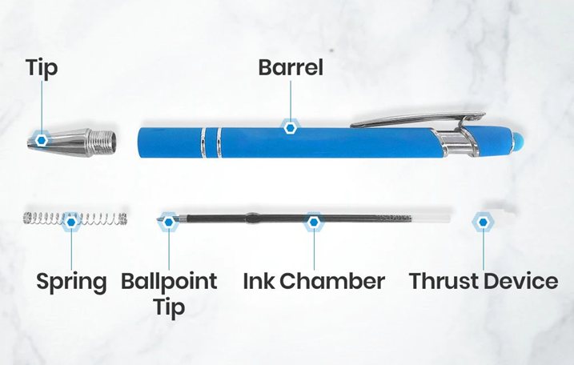

Slide 4
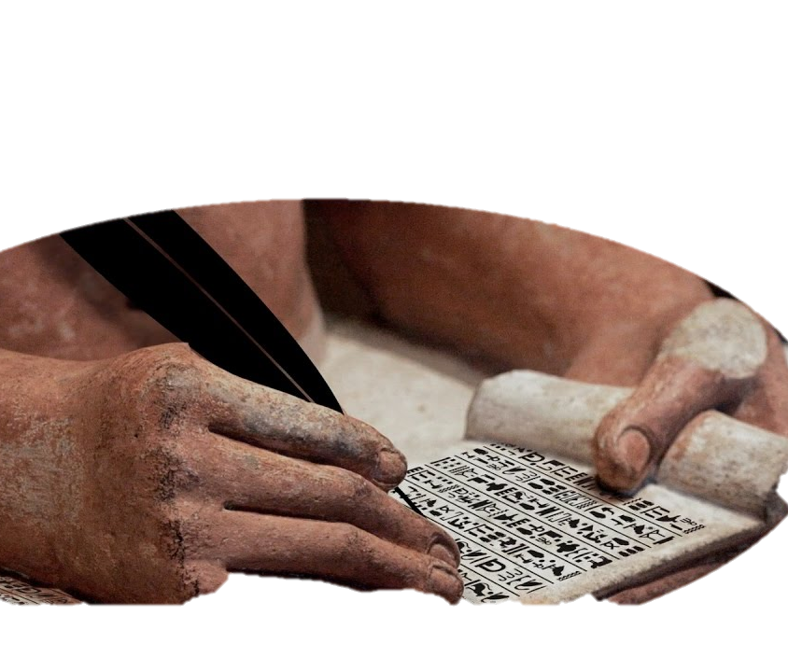
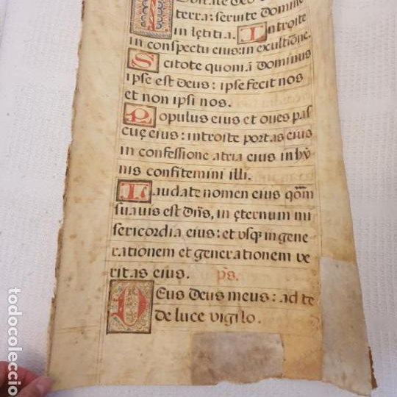

What did the people do before this invention?
Before the ballpoint pen was invented, people used to write with pen and ink.
Much further back people wrote on stone, with a hard material (like a stick) they would poke on the stone and leave a mark.
They also wrote on a animal skin or in a scrolls

Slide 5
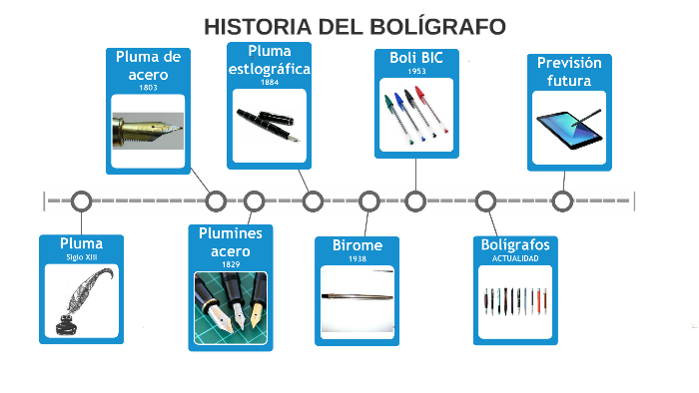
How has this invention changed through history?
PEN
(feather)
STEEL NIBS
BALLPOINT PEN
PEN
STEEL PEN
STYLOGRAPHIC PEN
BIC PEN

Slide 6

THE
END
So far the presentation, I hope you liked it and thank you for your attention

