Slide 1
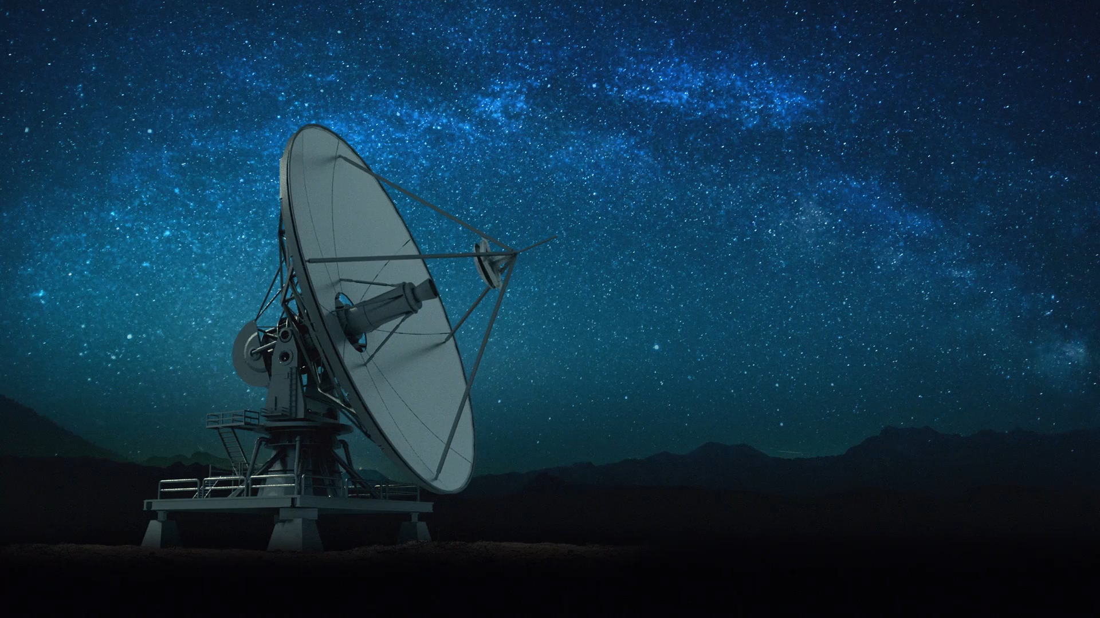
THE TELEVISION
Grup: 3
Arnau Martin Álvarez
Alannah González García
Soraya Castillo Vivo

Slide 2


When was invented? Who invented it?
Electronic television was first successfully demonstrating in San Francisco on Sept. 7, 1927. The system was designed by Philo Taylor Farnsworth, a 21-year-old inventor who had lived in a house without electricity until he was 14.

Slide 3
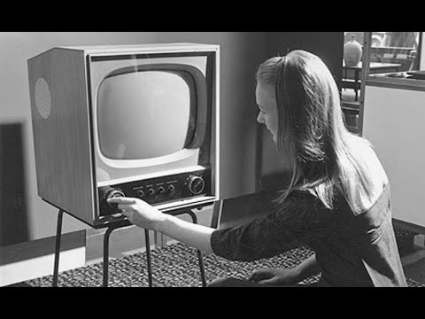
How does it work?
Is a telecommunication medium used for transmitting moving images in monochrome (black and white), or in a colour, and in two or three dimensions and sound.

Slide 4

What did the people do before this invention?
Television was invented after radio, so before having television in their homes they used the radio to find out what was happening in their cities/towns.

Slide 5

How has this invention changed through history?
Television production was developed with technical advances that allowed the recording of audio and video signals. This allowed the realization of recorded programs that could be stored and broadcast later.

Slide 6


